Slide 1
SMAPwn
a faster way for detecting double fetch vulnerabilities in Windows kernel
by Artem Shishkin
@honorary_bot

Slide 2
disclaimer
I am presenting the contents of this presentation in my personal capacity. The views expressed are solely my own and do not necessarily reflect the views of Intel Corporation or its affiliates.

Slide 3
Whoami
Security researcher at Intel Corporation
I like Windows kernel

Slide 4
DOUBLE FETCH VULNERABILITIES
TOCTOU:
pStruct->size checked
… ← this is when we change it
pStruct->size used
Two sequential references to the same address in this case
Can we track it?

Slide 5
We can track it
And the guys did that using Bochs
Bochspwn by Mateusz "j00ru" Jurczyk and Gynvael Coldwind
https://research.google.com/pubs/archive/42189.pdf
Bochs means instrumenting the whole system
A bit slow
BSDaemon and NadavCh did that using Simics
https://github.com/rrbranco/poc_gtfo/blob/master/pocorgtfo15.pdf
Are there different ways of tracking?

Slide 6
SMAP
Supervisor Mode Access Prevention
When a code runs on Ring 0 (CPL = 0) and tries to access a user mode page (PTE.U\S bit = 1) a page fault is raised
Configured by CR4.SMAP bit
STAC \ CLAC instructions may be used to control SMAP operation
Windows does not use SMAP … yet (RS5 will)

Slide 7
The idea
Use SMAP to track kernel references to usermode memory
Gather the needed info
Code address that caused an exception
Address that the code tried to access
Timestamp
Apply filtering if needed
Filter the log data
Apply in runtime to increase performance

Slide 8
IMPLEMENTATION #1
A debugger script
Enable SMAP
Place a breakpoint on KiPageFault
Check if it is caused by SMAP violation
Log all necessary data
Disable SMAP
Perform a single-step
GOTO 1

Slide 9
IMPLEMENTATION #1 advantage
The fastest way to implement the idea
Maybe even the easiest way as well

Slide 10
IMPLEMENTATION #1 DRAWBACKs
Slow
Debug transport latency
WinDBG / KD latency
Unstable
Not thread safe
There is a chance for a context switch while CR4.SMAP is disabled

Slide 11
Implementation #2
A debugger plugin
Enable SMAP
Implement a custom page fault handler
Implement a custom debug trap or fault handler
Patch system handlers
Go!

Slide 12
Implementation #2 ADVANTAGES
Target OS operates way faster
Since the target is being kernel debugged, the PatchGuard will not complain about kernel modifications

Slide 13
Implementation #2 DRAWBACKS
Still not the fastest way of target execution
Because log go to WinDBG \ KD, which causes some latency
Kernel debugger is required

Slide 14
Implementation #3
Autonomous kernel mode driver
Implements the same stuff as #2

Slide 15
Implementation #3 ADVANTAGES
Maximum target OS execution speed
Since logging is local
No need for kernel debugging

Slide 16
Implementation #3 DRAWBACKS
Still you have to tame the PatchGuard

Slide 17
IMPLEMENTING #2
Implement custom exception handlers as an injectable asm code
Locate a space in Windows kernel to place the asm code
Load the asm code
Patch the OS IDT entries

Slide 18
Custom page fault handler
Check whether the page fault is SMAP related
Check the error code of #PF
Check if saved RIP is a kernel address (higher part of virtual address space)
Check if CR2 (linear page fault address) is a user address
Disable SMAP by setting RFLAGS.AC flag
Log the needed info
Saved RIP is a code address that caused an exception
CR2 is an address the kernel module tried to access
RDTSC as a timestamp
Anything else, symbol info may be used to resolve any kernel info
Format the log buffer and call nt!DbgPrintEx to send the data to the debugger
Set saved RFLAGS.TF to 1, that will cause a single-step exception on thread resume
IRETQ or jump to the original Page Fault Handler

Slide 19
Custom debug trap or fault handler
Check if a SMAP logging event resume (ID flag of RFLAGS)
Otherwise it is just a regular single step in the debugger
Enable SMAP by resetting RFLAGS.AC flag
Reset TF for saved RFLAGS
IRETQ

Slide 20
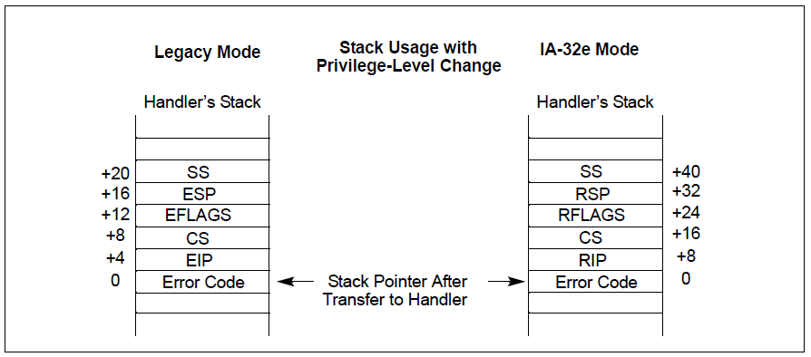
Stack layout after exception

Slide 21
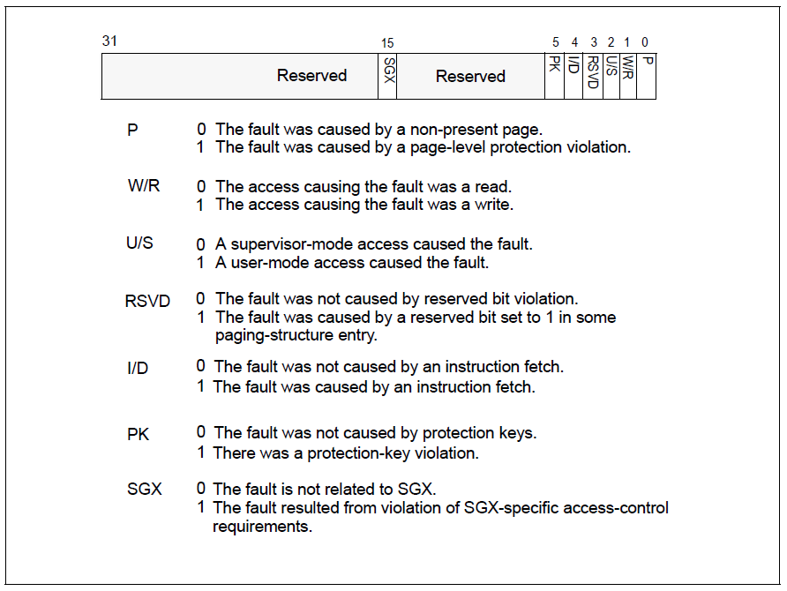
Page fault error code

Slide 22
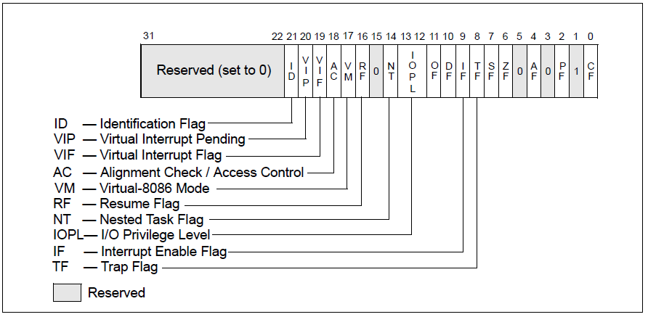
Rflags register
ID flag can be used as a spare bit

Slide 23
LOCATING A PLACE FOR PLUGIN DATA
KUSER_SHARED_PAGE
Has plenty of space
Located at fixed address
Will not be reused
Patch kernel PTE to make it executable
Load your code and data there

Slide 24
WINDBG plugin
Automatic mode
Just logs everything
Manual mode
Executes until next SMAP violation
Target module filtering
Can target against a specific kernel module in runtime

Slide 25
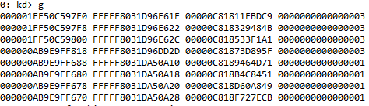
It’s working
Sample output
Referenced address
Code that referenced
TSC
Error code
The results are to be post-processed

Slide 26
Thank you!
And a huge thanks to my team “STORM” at Intel for support and participation
And the guys who already used the approach

Slide 27
QUESTIONS?

